Slide 1
PARALLEL & DISTRIBUTED COMPUTING

Slide 2
GROUP MEMBERS
MUHAMMAD ASFAND YAR KHAN NIAZI
DANISH KHALIL PERVEZ
DANIAL RAJPOUT
MUHAMMAD HASEEB

Slide 3
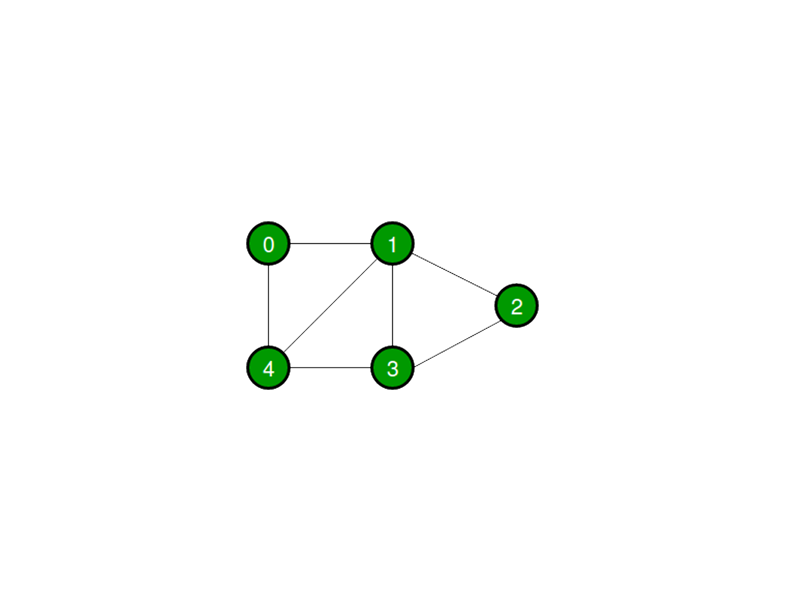
GRAPH
A graph G is a an ordered pair of a set V of vertices and a set E of edges.
G = ( V, E )
There are two types of graphs:
Directed graph.
Un-directed grapgh.

Slide 4
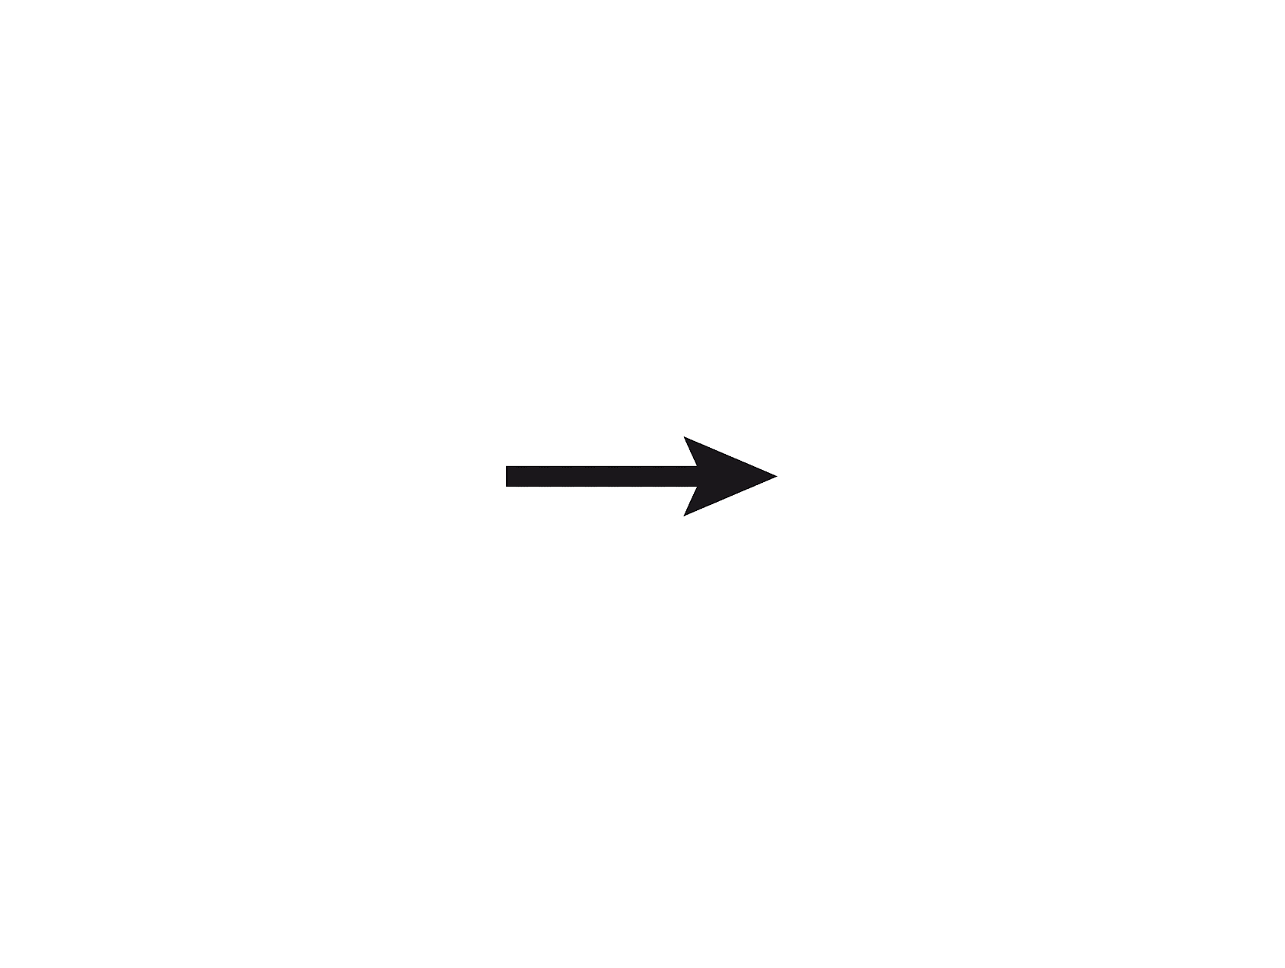
Directed Graph
A graph is a directed graph when the pair of vertices
representing any edge by an ordered or a direct pair
(V_{1,} V₂), where V₁ is the tail and V₂ is the head of the edge.
V₁ V₂
Thus (V_{1,} V₂) and ( V_{2,} V_{1,}) represent two differant edges.

Slide 5
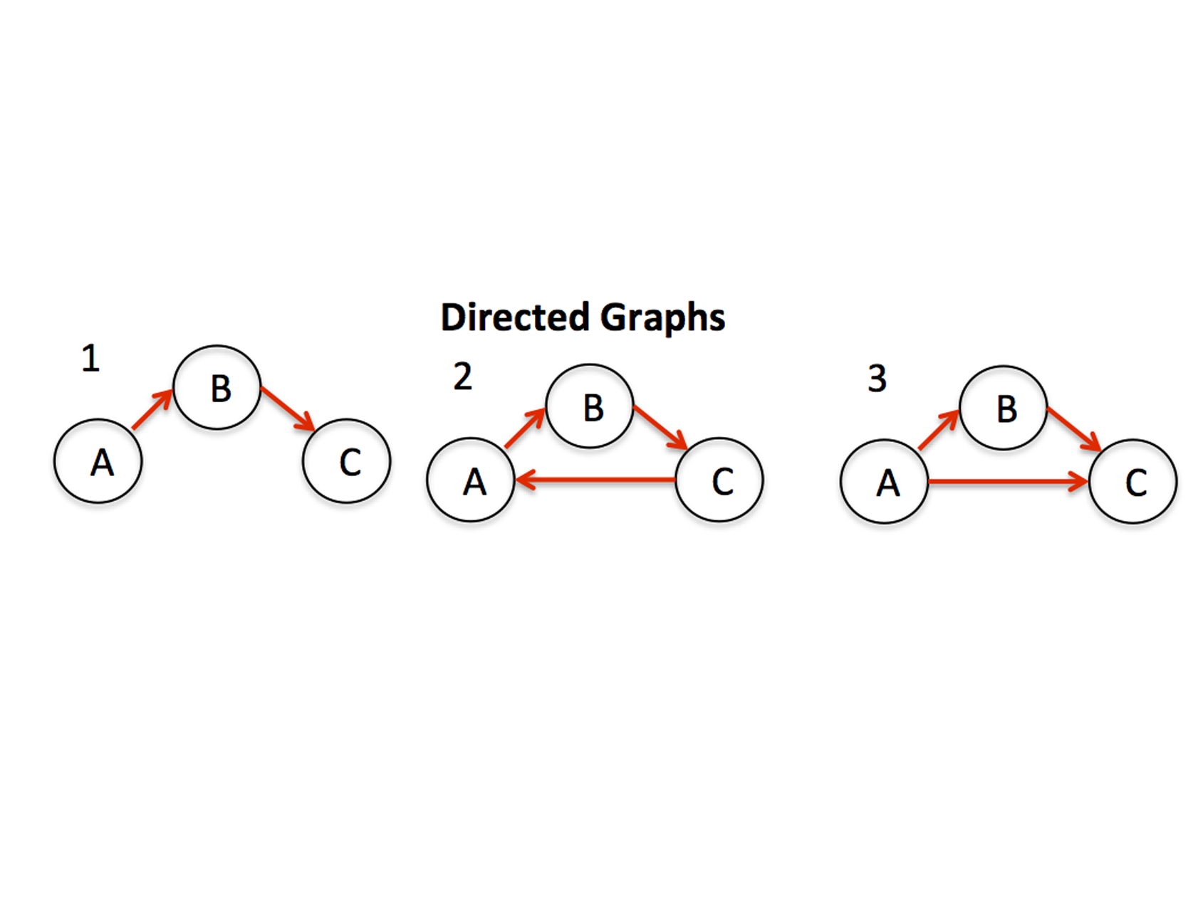

Slide 6
UN-Directed Graph
A graph is called un-directed graph when the pair of vertices
representing any edge is un-ordered.
Thus (V_{1,} V₂) and ( V_{2,} V_{1,}) represent the same edges.

Slide 7
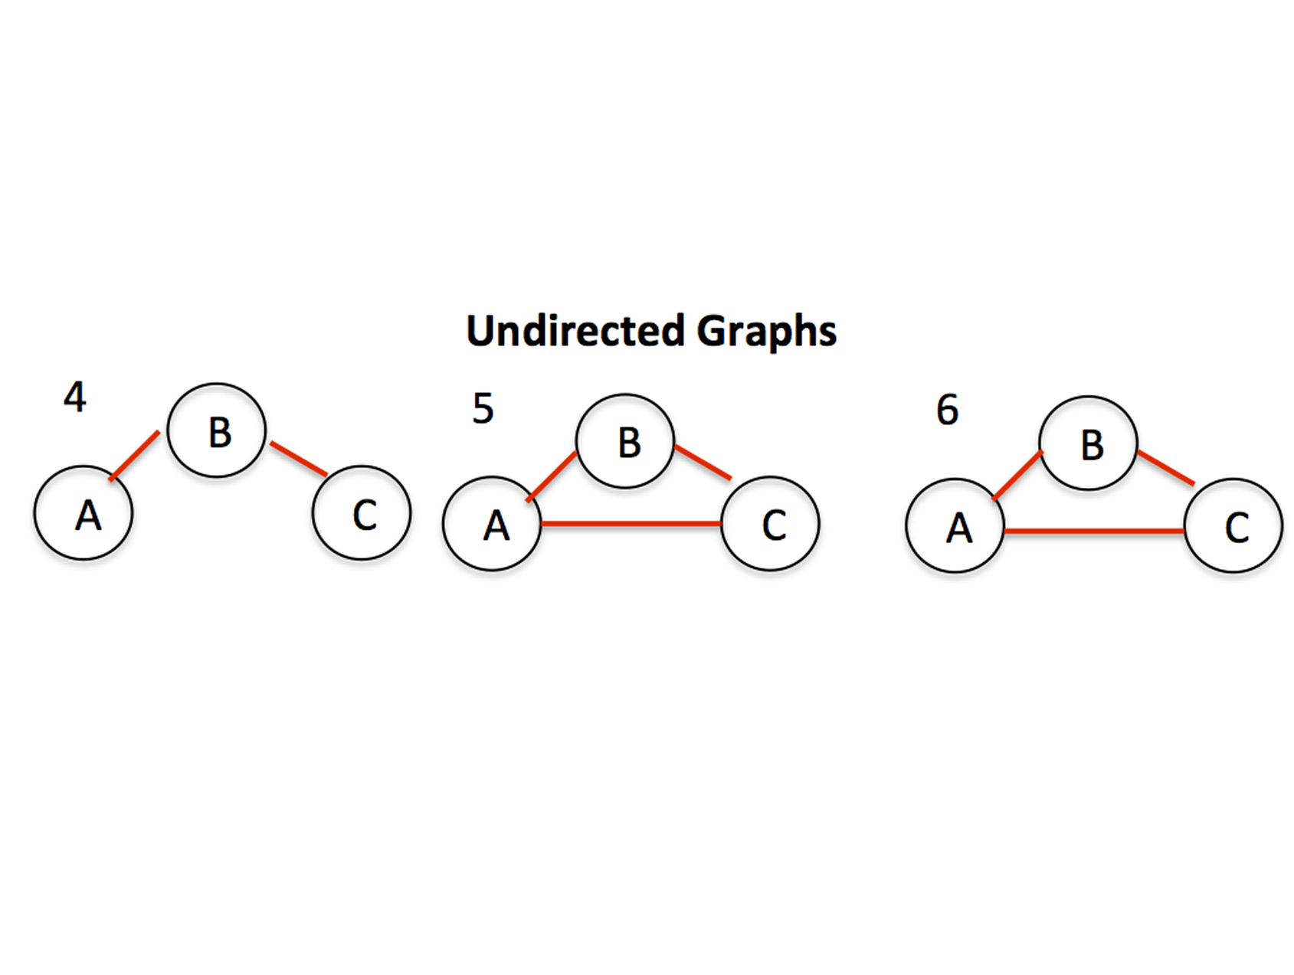

Slide 8
Graph
Representation
There are two types of grapgh representations:
Adjacency matrix representation.
Adjacency list representation.
Adjacency matrix representation:
An adjacency matrix is a way of representing
a graph as a matrix of booleans (0's and 1's).

Slide 9
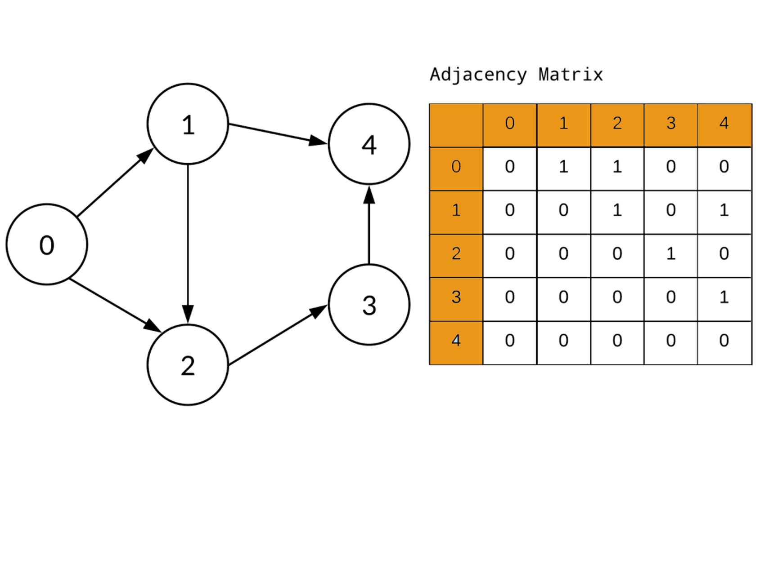

Slide 10
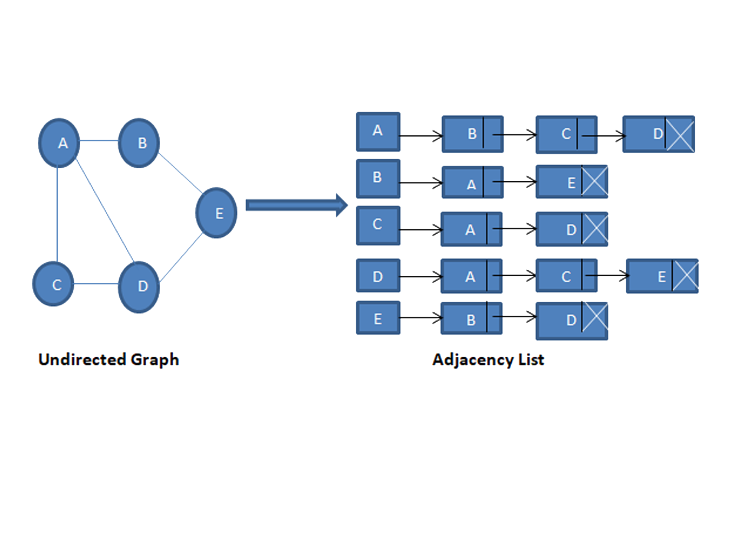
Adjacency list representation:
An Adjacency list is an array consisting of the address of all the linked lists. The first node of the linked list represents the vertex and the remaining lists connected to this node represents the vertices to which this node is connected.

Slide 11
Introduction to Prim’s Algorithm:
Prim’s algorithm is used to find the Minimum Spanning Tree for a given graph. But, what is a Minimum Spanning Tree, or MST for short? A minimum spanning tree T(V’, E’) is a subset of graph G(V, E) with the same number of vertices as of graph G (V’ = V) and edges equal to the number of vertices of graph G minus one (E’ = |V| - 1.

Slide 12
How to Create MST Using Prim’s Algorithm:
Let’s first look into the steps involved in Prim’s Algorithm to generate a minimum spanning tree.
Step 1: Determine the arbitrary starting vertex.
Step 2: Keep repeating
Step 3: Select an edge connecting the tree vertex and fringe vertex having the minimum weight.
Step 4: Add the chosen edge to MST if it doesn’t form any closed cycle.
Step 5: Exit

Slide 13
Graph G(V, E) given below contains 9 vertices and 12 edges. We are supposed to create a minimum spanning tree T(V’, E’) for G(V, E) such that the number of vertices in T will be 9 and edges will be 8 (9-1).

Slide 14
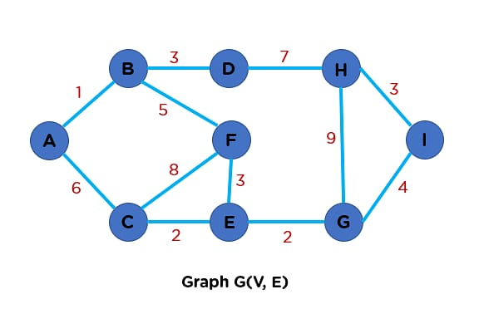
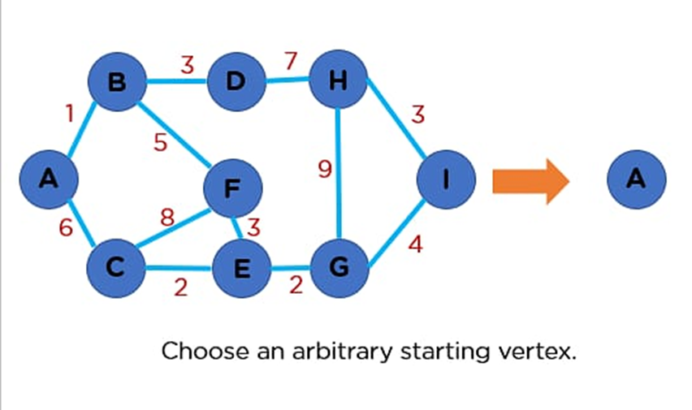

Slide 15
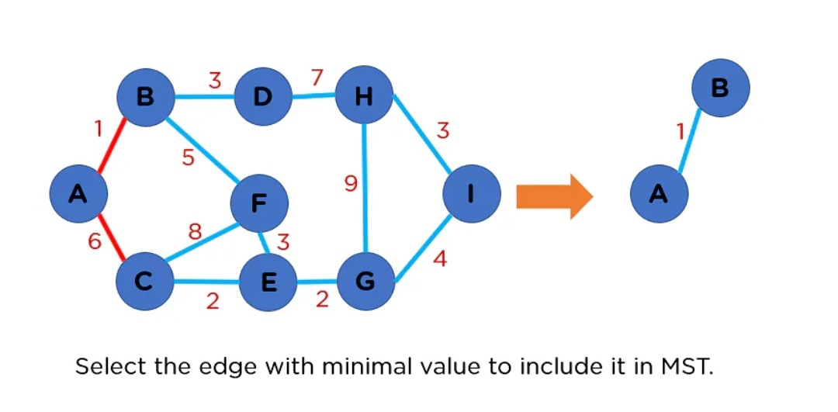

Slide 16
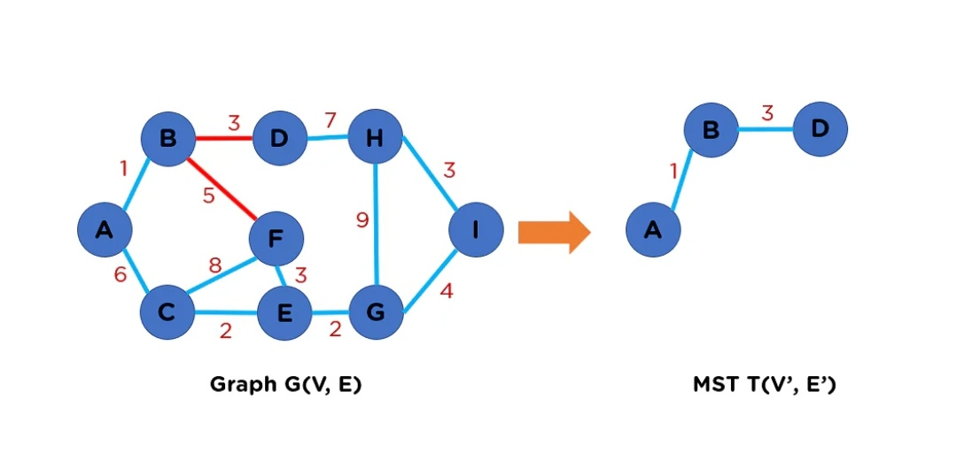

Slide 17
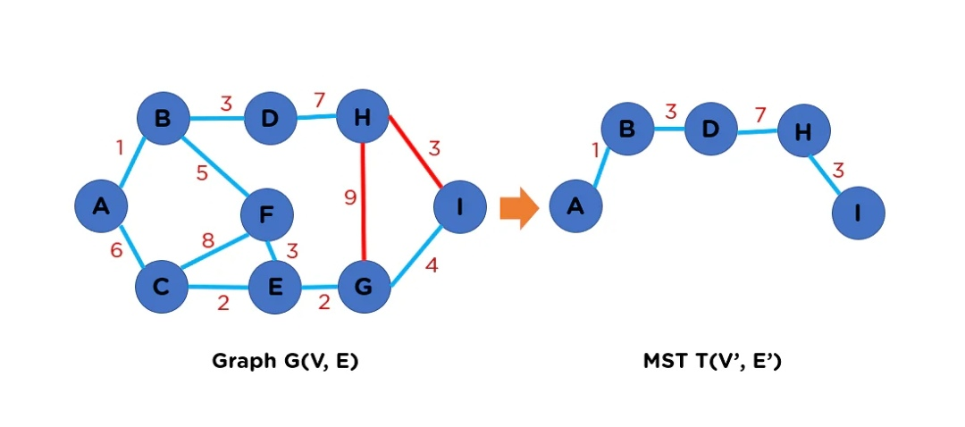

Slide 18
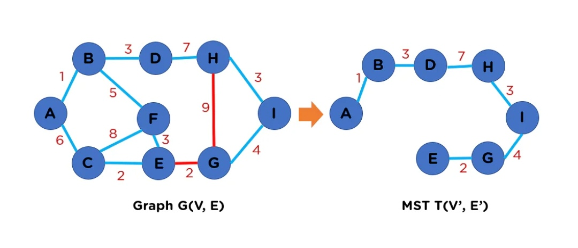

Slide 19
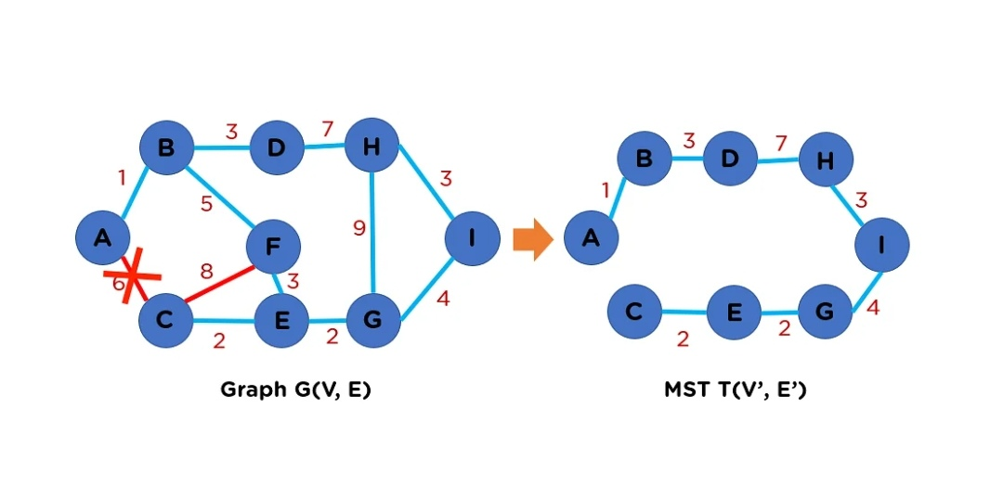

Slide 20
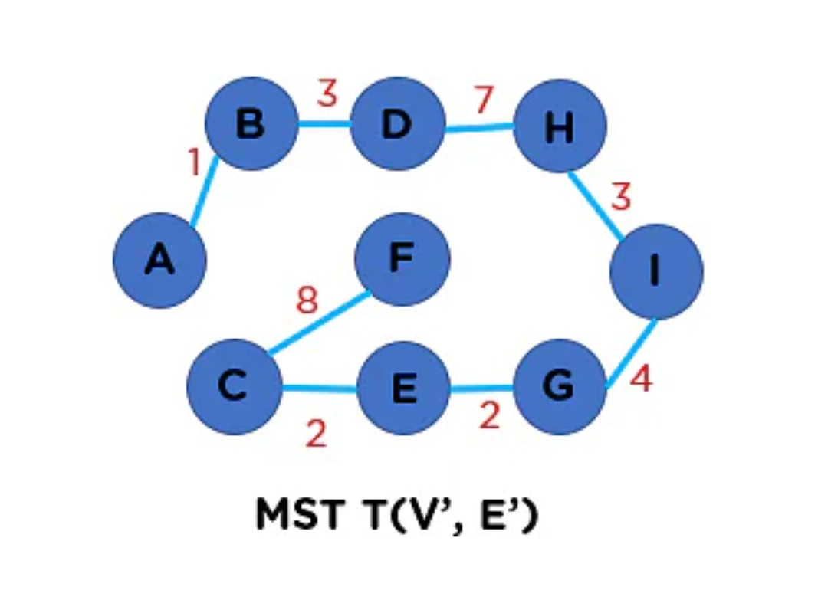

Slide 22
DIJKSTRA’S ALGORITHM
Iterative Algorithm. For shortest path.
Does not work with negative weight graph.
Example:
Step 1: Remove loop.
Step 2: Remove parallel edges. With max weight.
Step 3: Create weight matrix table.

Slide 23
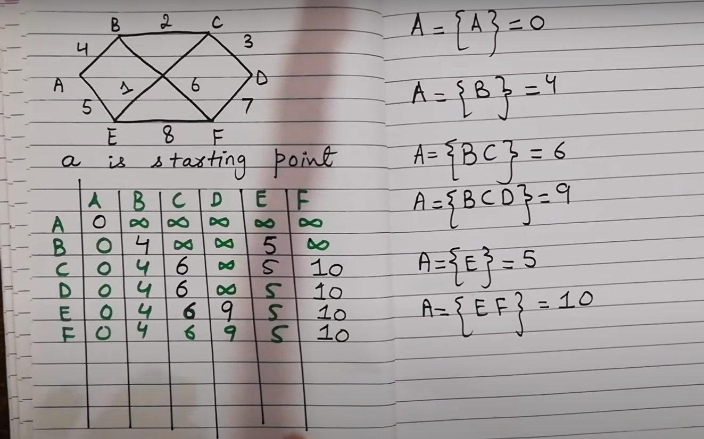

Slide 24
All pairs shortest path
The all pair shortest path algorithm is used to find all pair shortest path problem from a given weighted graph. As a result of this algorithm, it will generate a matrix, which will represent the minimum distance from any node to all other nodes in the graph.

Slide 25
Dijkstra’s algorithm : parallel formulation
• Two parallelization strategies – execute each of the n shortest path problems on a different processor (source partitioned)
or use a parallel formulation of the shortest path problem to increase concurrency (source parallel)

Slide 26
Dijkstra’s algorithm : parallel formulation:
source partitioned formulation
source parallel formulation
Use n processors, each processor Pi finds the shortest paths from vertex vi to all other vertices by executing Dijkstra’s sequential single-source shortest paths algorithm
Parallel execution time. Θ(n2).
• In this case, each of the shortest path problems is further executed in parallel. We can therefore use up to n2 processors.
• Given p processors (p > n), each single source shortest path problem is executed by p/n processors.
Parallel execution time TP= Θ (n3/p)+ Θ(n log p)

Slide 27
Floyed warshall algorithm:
Floyd-Warshall algorithm is also called as Floyd’s algorithm, Roy-Floyd algorithm, Roy-Warshall algorithm
Floyd–Warshall’s Algorithm is used to find the shortest paths between all pairs of vertices in a graph, where each edge in the graph has a weight which is positive or negative.
The biggest advantage of using this algorithm is that all the shortest distances between any 2 vertices could be calculated in O(V3), where V is the number of vertices in a graph.

Slide 28
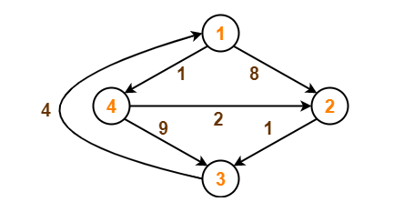
Example:

Slide 29
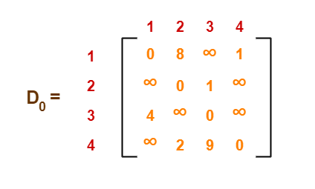
Cont…..
Write the initial distance matrix.
It represents the distance between every pair of vertices in the form of given weights.
For diagonal elements (representing self-loops), distance value = 0.
For vertices having a direct edge between them, distance value = weight of that edge.
For vertices having no direct edge between them, distance value = ∞

Slide 30
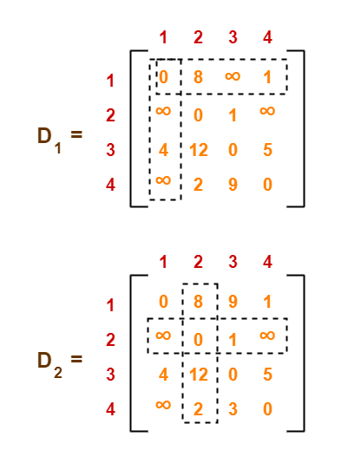
Cont….
Now we will use the will find the remaining matrixes.

Slide 31
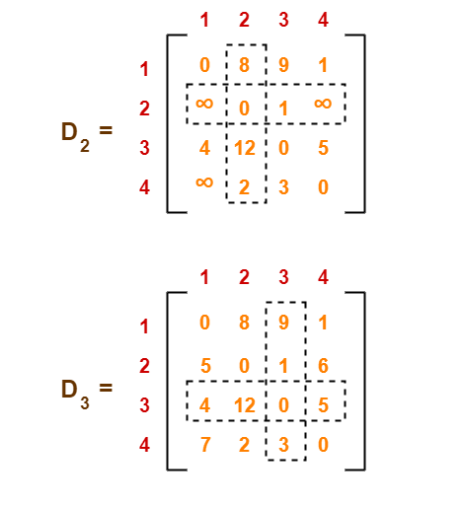
Cont….

Slide 32
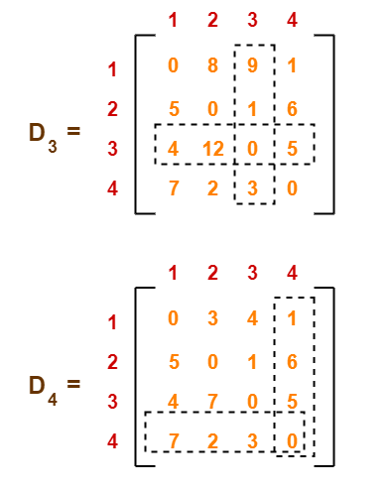
Cont….

Slide 33
Thanks for your Attention

